Slide 1


Learning Fast and Slow
John E. Laird
John L. Tishman Professor of Engineering
University of Michigan
37th Soar Workshop
June 5, 2017
Notes:
My research goal is Human-Level AI – all of the cognitive capabilities of a human. Essentially Artificial General Intelligence.
Recognition, categorize, prediction.

Slide 2
The Soar Cognitive Architecture
Symbolic Long-Term Memories
Procedural
Semantic
Episodic
Reinforcement
Learning
Chunking
Semantic
Learning
Episodic
Learning
Symbolic Working Memory
Decision Procedure
Spatial Visual System (SVS)
Model learning
controller
Object-based continuous metric space
Motor learning
Percept learning
Perception
Action
Laird, J. E. (2012). The Soar Cognitive Architecture. MIT Press.
Notes:
No “task learning module” – no natural language module either.
Note – META DATA

Slide 3
Hypothesis: Two Kinds of Learning
L1: Architectural Learning Mechanisms
Captures knowledge from an agent’s ongoing experiences.
Perceptual, procedural, semantic, episodic, motor, ...
L2: Knowledge-based Learning Strategies
Create experiences for L1 mechanisms to learn.
Examples: Practice an activity, run a scientific experiment.

Slide 4
L1: Architectural Learning Mechanisms
Automatic
Innate, effortless, fast, online, always active
Bottom up, data driven
Learn directly from agent’s experiences
Perceptual and internal structures
Temporally local
Diverse mechanisms for diverse representations
Neural networks
Graphical models
Relational symbolic representations
<Quantum?>
Notes:
Kahneman – not decision making but learning.

Slide 5
L2: Knowledge-based Learning Strategies
Deliberate
Initiated and controlled by agent knowledge
Are “tasks” for the agent and competes with task reasoning
Can be learned and improved with experience
Do not directly modify long-term memory
Use existing capabilities to create experiences for L1
Action, analogy, attention, decision making, dialog, goal-based reasoning, meta-reasoning, natural language reasoning, planning, spatial reasoning, temporal reasoning, theory of mind, …
Allow generative heterogeneous and non-local learning
Can combine different types of knowledge acquired over time
Examples:
Deliberate rehearsal, explicit training regimes (studying), self-explanation, learning by instruction, after-action review, …
Notes:
Kahneman – not decision making but learning.
No L2 architectural “boxes”

Slide 6
Reinforcement Learning: L1 or L2?
L1: Updates to value function
Modifying parameters:
Learning rate?
Fixed, or fixed schedule, or dependent on task?
Exploration/exploitation tradeoff?
Fixed, or fixed schedule, or dependent on task?
L2: Overall strategy:
Number of training trials?
Intermixing of training?
Using internal planning or acting in the world?

Slide 7
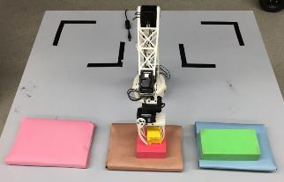
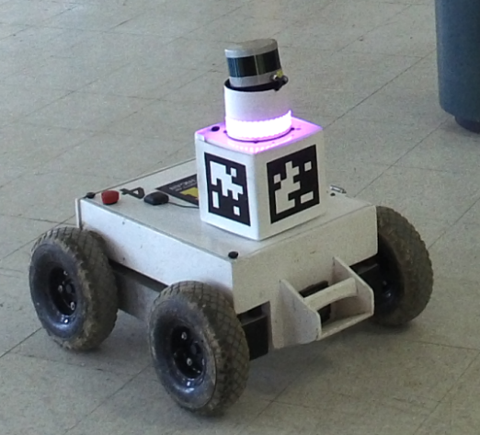
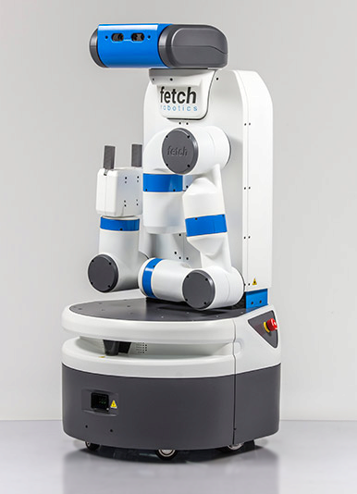
L2: Interactive Task Learning
Learn new tasks through natural interactions with humans.
Rosie
Implemented in Soar: lots of procedural and semantic knowledge – no new learning mechanisms
Acquires task definition knowledge
Concept definitions, hierarchical goal descriptions, failure states, task constraints, task actions, heuristics
>30 puzzles and games, and mobile robot tasks

Slide 8
Task Learning Processing
Perceiving Environment
Comprehend Language
Construct Task Representation
Interpret Task Representation
Search for Solution
Act in the World
Task learning is a side effect of these activities
Notes:
Where is “learning”?

Slide 9
Interpret and Operationalize Task Representation
(w1 ^game(g1 ^name tower-of-hanoi
^struct(a1 ^goal (g1 ...)
^operator(c1 ^name stack
^arg(C11 ...)
(C12 ...))
Task
Representation
Working
Memory
+
Environment
Representation
(w1 ^object (o1 ^type block ^color yellow ^size small)
(o2 ^type block ^color red ^size medium)
...
^relation (r1 ^type on ^arg1 o1 ^arg2 o2)
...
^property (p1 ^name clear ^object o1))
Deliberate reasoning
(Procedural Memory)
(o1 ^name stack
^arg1 block1
^arg2 block3)
Chunking converts deliberate processing to reactive processing (80x speedup)
Environment
Notes:
Goal is not to solve natural language processing, vision,
Claim sufficient progress in each of these systems to design end to end system

Slide 10
Search for Solution and Act in the World Working, Procedural → Working, Procedural
If search fails, agent asks for instruction to lead to solution. Once solution is found, agent performs retrospective analysis based on episodic memories to understand why it succeeded. Chunking converts to control rules.
If know what to do, do it.
Otherwise search for solution constrained by learned heuristics.
If search succeeds, chunking converts search results into control rules (a policy) to select actions.
Reinforcement learning tunes decisions based on performance (not yet).
Notes:
Goal is not to solve natural language processing, vision,
Claim sufficient progress in each of these systems to design end to end system

Slide 11
More that L1 and L2?
L0: Evolution: Creates L1 Mechanisms
L1: Architectural Learning Mechanisms
L1.5: Innate Strategies
Initiate behavior that creates experiences that aid learning
Not deliberately initiated to enhance learning
Examples: curiosity, play in young animals, social …
L2: Knowledge-based Learning Strategies
Wild speculation: L2 strategies are unique to humans

Slide 12
Which is Fast and Which is Slow?

